Slide 1
Simultaneous Roundtable
Mr. Holby, Mrs. Kudaisi, Ms. Polizzi

Slide 2

Description:
Simultaneous RoundTable
In teams, students each write a response on their own piece of paper. Students then pass their papers clockwise so each teammate can add to the prior responses.
Setup: Each team of four needs four papers and four pencils.

Slide 3
Suggestions for this structure
Beginning a lesson or unit to activate brains, assess prior knowledge
During a concept to formatively assess
At the end of a concept/unit/lesson to see if mastery was attained

Slide 4
Steps:
Simultaneous
RoundTable
Step 1- Teacher assigns a topic or question and provides think time.
Step 2 - All 4 students respond, simultaneous writing, drawing, or building something with manipulatives.
Step 3 - The teacher signals time, or students place thumbs up when done with the problem.
Step 4 - Students pass papers or projects one person clockwise.
Step 5 - Students continue, adding to what was already completed.
Step 6 - Students pass papers or projects 1 person clockwise. Continue, starting at Step 3.

Slide 5
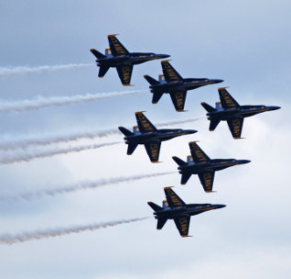


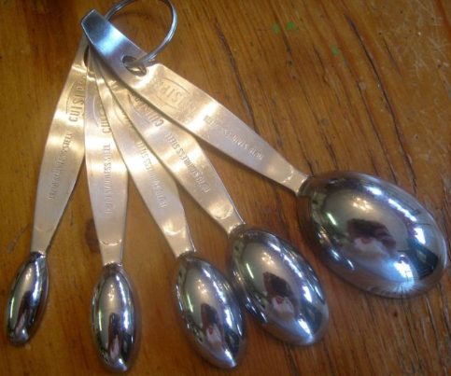
Identify a transformation and name one of its properties.
Transformations

Slide 6
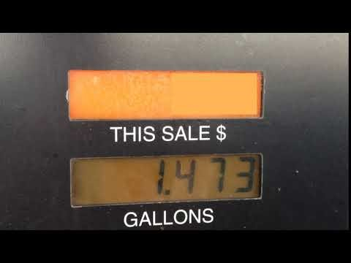
Describe a method you could use to calculate the amount customer would pay.
Proportional Reasoning

Slide 7
Describe a method you could use to calculate the amount customer would pay.
Proportional Reasoning

Slide 8
How much would the customer pay if they used 10.884 gallons.
Proportional Reasoning

Slide 9
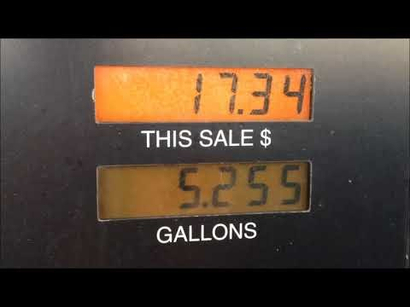
Was the answer correct based on the video?
Proportional Reasoning
Was your prediction correct?

Slide 10
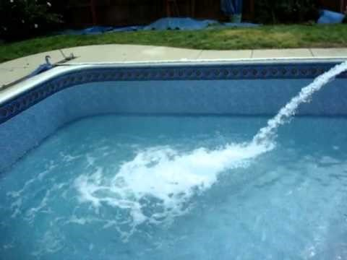
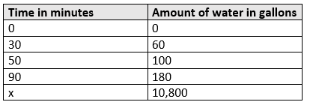
What do you notice about the table?

Slide 11
What else do you notice about the table?

Slide 12
Make a prediction of how long it would take for the pool to fill up the 10, 800 gallon pool. Support with evidence.

Slide 13
Do you agree or disagree? Support with evidence.

Slide 14
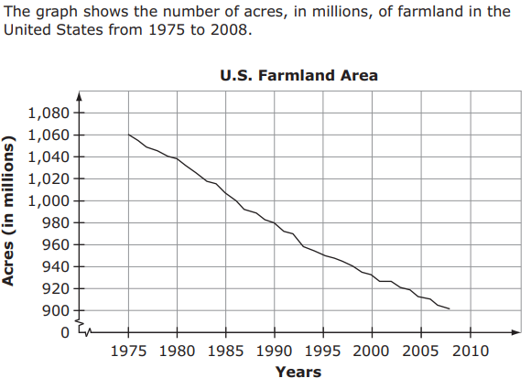
Round 1: Choose a point on the graph and describe what it represents.

Slide 15
Round 2-3: Choose a different than what the previous chose and describe what it represents.

Slide 16

Round 1: Choose a point on the table and describe what it means.
Number of Views | Amount Earned
80,000 | $160
160,000 | $320
240,000 | $480
320,000 | $640
400,000 | $800
480,000 | $960
560,000 | $1,120

Slide 17
Round 2: What is the rate of change for information provided?
Number of Views | Amount Earned
80,000 | $160
160,000 | $320
240,000 | $480
320,000 | $640
400,000 | $800
480,000 | $960
560,000 | $1,120

Slide 18
Round 3: Write two sentence summary of the graph.
Number of Views | Amount Earned
80,000 | $160
160,000 | $320
240,000 | $480
320,000 | $640
400,000 | $800
480,000 | $960
560,000 | $1,120

