Slide 1
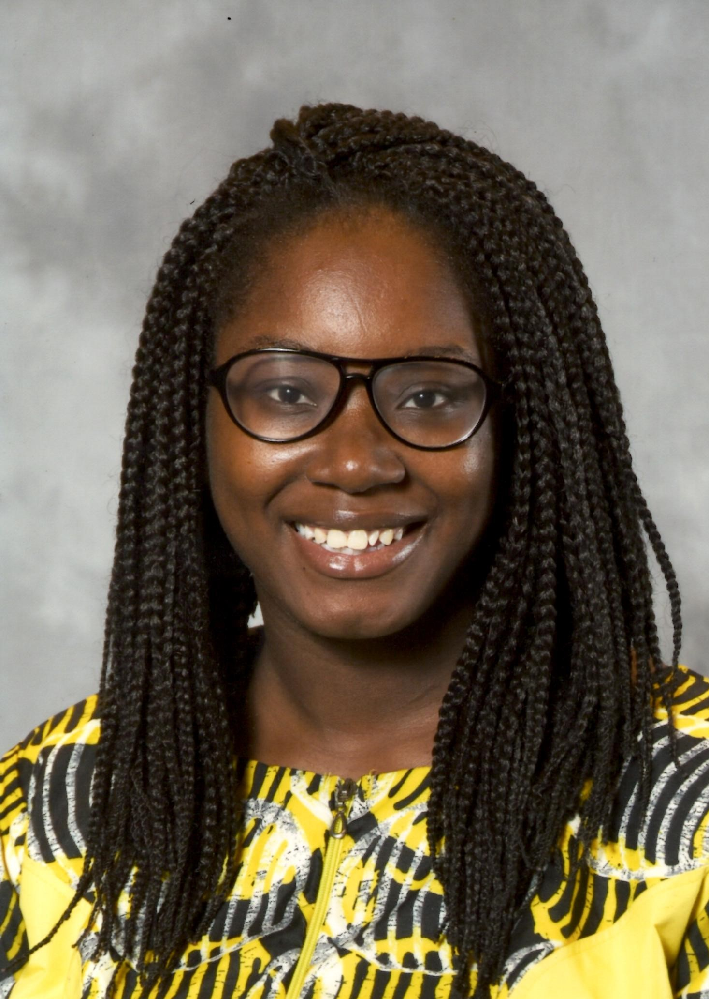
Who Am I?
Queshonda Kudaisi
Polk County Schools Instructional Mathematics Coach
University of South Florida College of Education – Doctorate Student
Qjkudaisi@mail.usf.edu

Slide 2
Engaging Students in Noticing and Wondering to Promote Critical Thinking Skills
Queshonda kudaisi
The ART of Noticing, Wondering, and Thinking
Notes:
October 12, Saturday , 9:15-10:15, City Terrace 7 Room

Slide 4
What can we do to increase student achievement?

Slide 5
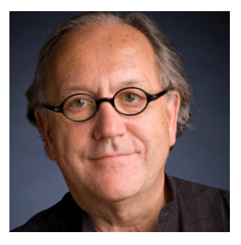
“There are only three ways to improve student learning at scale: You can raise the level of the content that students are taught. You can increase the skill and knowledge that teachers bring to the teaching of that content. And you can increase the level of students’ active learning of the content.”
~ Richard F. Elmore

Slide 6
Student Centered Engagement Strategies
What are some of the barriers to student engagement for teachers?

Slide 7
Reshaping Our Mindset Toward Student Centered Learning
From This | To This
It waste time. | Its connecting students to and engaging students in the lesson.
It’s too noisy. | Students are gaining perspectives other than the teachers.
Responses are off topic. | I can redirect responses back on topic.
Responses are random. | It connects student thinking to mathematical ideas.
Some of my students don’t learn that way. | Some of my students learn that way.
Students get off topic and talk about other things. | I can put a structure in place that limits this.

Slide 8
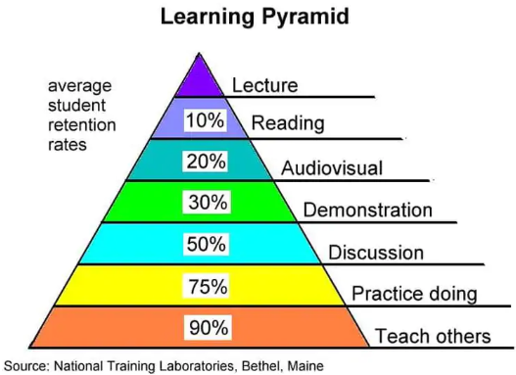

Slide 9
Learning Target
Understand what the I Notice, I Wonder Routine is
To understand the type of prompts that can be used in your class
To review the times when it can be used instruction
To review resources that give you access to I Notice, I Wonder Prompts

Slide 10
Student Engagement Strategy
Noticing and Wondering

Slide 11
Notice and Wondering
Noticing and Wondering for Administrators
Noticing and Wondering for Mentors and Coaches (Roller, 2019)
Professional Noticing of Children’s Mathematical Thinking for Teachers (Jacob et. Al, 2010)
Noticing and Wondering for Students (Ray-Reick, 2013)

Slide 12
Edutopia
An instructional routine in which students are given a prompt in a visual, verbal, and/or written format. Afterward students generate responses to what they notice and wonder about the prompt.

Slide 13
Barriers For Students
Students don’t know how to begin solving word problems.
They don’t trust or make use of their own thinking.
They freeze up or do any calculation that pops into their head, without thinking, “does this make sense?”
They don’t have ways to check their work or test their assumptions.
They miss key information in the problem.

Slide 14
The Routine:
Call on students and record their noticing's at the front of the room.
Thank or acknowledge each student equally.
Record all student suggestions.
Avoid praising, restating, clarifying, or asking questions.
Repeat for the wondering portion.

Slide 15
NCTM’s Levels to Noticing and Wondering
Level 1: “I Notice, I Wonder” Brainstorm
1
Level 2: Forget the Question – Access for All Students
2
Activity 3: Think/Pair/Share – Increasing Engagement and Accountability
3
Notes:
https://www.nctm.org/Classroom-Resources/Problems-of-the-Week/I-Notice-I-Wonder/

Slide 16
Level 1: Whole Group Brainstorm
In order for Leon to earn checks from YouTube, he must have a certain number of views on his videos. In the past three weeks, he already has 42,000 views. How much money would you receive for 40,000 views? Justify your answer.
What do you notice & wonder?
Number of Views | Amount Earned
80,000 | $160
160,000 | $320
240,000 | $480
320,000 | $640
400,000 | $800
480,000 | $960
560,000 | $1,120

Slide 17
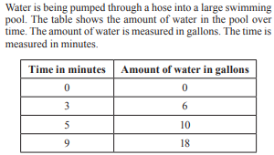
Level 2: Whole Group Brainstorm What do you notice, what do you wonder?

Slide 18
Level 3: Think (Write responses on note cards), pair, share: What do you notice, what do you wonder?

Slide 19
Discuss with your shoulder partner. 1. What difference does make between having a question in the prompt and not having a question? 2. What kind of thinking takes place in both instances? 3. What difference does having students respond in writing make vs. not?

Slide 20
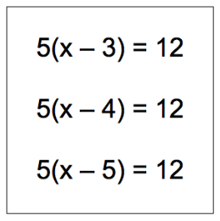
Think, pair, share: What do you notice, what do you wonder?

Slide 21
Think, pair, share: What do you notice, what do you wonder?
For every 0.00013 ounces of chlorine there is one gallon of water. Discuss with your partner some possibilities of finding the amount of chlorine in 5 gallons and come up with a solution.

Slide 22
Think, pair, share: What do you notice, what do you wonder?
How much do you think that the person would end up paying for gas? Discuss with and work with a partner and justify your answer.

Slide 23
The Big Reveal

Slide 24
Discuss with your shoulder partner How can this strategy help teachers connect to and build on student responses?

Slide 25
With your shoulder partner, discuss how this routine could be beneficial for students.

Slide 26
Benefits of Noticing and Wondering For Students
Everyone has an entry point.
Everyone gets to engage.
Diverse perspectives enrich the class.
Open-endedness invites depth.

Slide 27
With your shoulder partner, discuss how this routine could be beneficial for teachers.

Slide 28
Benefits of Noticing and Wondering For Teachers
The routine is well defined and easy to implement.
Internalizing a routine frees up instructional time.
Internalizing a routine frees up instructional energy.
It promotes positive math culture.

Slide 29
Discuss with your shoulder partner, when do you think this strategy could be used instruction?

Slide 30
K20 Center

Slide 31
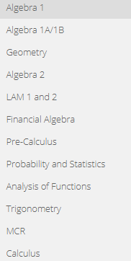
Consider these before creating your own prompt
Start with the Standards
Use something that connects to students’ experiences
Frame it so that it is not a question
Opened ended

Slide 32
Useful Resources
Open Middle
NCTM’s Classroom Resources
5280 Creative Math Prompts http://www.5280math.com/noticing-and-wondering
https://blog.mrmeyer.com/category/3acts/
https://whenmathhappens.com/3-act-math/
http://mathleadership.org/1648-2/

Slide 33
Feedback
Please note what you enjoyed and any suggestions for improvement!
Thanks and have a great day!

Slide 34
Useful Resources
This PowerPoint can be found at this website https://kudaisi.wixsite.com/extrastudying
Queshonda Kudaisi
qjkudaisi@mail.usf.edu

Slide 35
Who Am I?
Queshonda Kudaisi
Polk County School Board Educator
Lake Region High School - Instructional Mathematics Coach
University of South Florida College of Education – Doctorate Student
qjkudaisi@mail.usf.edu

